Slide 1
Pre-data presentation On CLOUD BASED SYSTEM FOR DIAGNOSING COVID-19 USING MACHINE LEARNING BY AJIBOYE Oluwaferanmi Kelechi 180202003 McPherson University, Seriki Sotayo, Ogun State. Department Of Physical And Computer Sciences, College of Natural and Applied Sciences, SUPERVISOR: Dr Femi Ayo Emmanuel & Mr Abiodun Mustapha

Slide 2
PRESENTATION OVERVIEW
Introduction.
Problem Statement.
Justification.
Aim and Objectives.
Literature Review.
Methodology
Expected Outcome
References

Slide 3

INTRODUCTION
In simplicity, Machine Learning is the ability of a computer system or program to learn from data, identify patterns and make decisions with minimal human intervention. (Sara Brown, 2021)
Machine learning focuses on the creation of computer programs that can access data and use it to learn for themselves. (Quiroz-Jua´rez et al, 2021)
COVID-19 is a deadly disease originating from a family of viruses knows as coronaviruses characterized by a core of genetic material covered with protein spikes. (Velavan & Meyer, 2020)
This virus is rapidly transmitted through respiratory fluids and has no direct cure at the time of this research. (WHO, 2022)

Slide 4
PROBLEM STATEMENT
The standard test for diagnosing COVID-19 in a patient is the PCR test: Reverse Transcriptase-Polymerase Chain Reaction (Fegert et al, 2020)
This testing procedure has multiple limitations including cost, limited kits available, speed of testing process (Afzal & Adeel, 2020).
With the rapid spread of the virus, triaging patients is a time-consuming process particularly for developing countries (Liu et al, 2020).

Slide 5
JUSTIFICATION
Research shows that an increased rate of testing patients will reduce the spread of the virus (Liu et al, 2020)
Testing should and must be made available to humans in all countries
AI can aid identification of hotspots of the virus. This can help government agencies enact lockdown and isolation rules in the region (Sivasubramanian, 2020)
Public data of the virus and how it can be detected will be increased when people can take preliminary diagnostic tests online (Abbasi et al, 2021)

Slide 6
AIMS AND OBJECTIVES
The aim of this study is to develop a cloud-based system that can detect the presence of COVID-19 in a patient using symptoms and other user data without performing a physical test
SPECIFIC OBJECTIVES
Perform a critical analysis on existing systems for detecting the coronavirus in patients using symptoms
Design a cloud-based system for detecting coronavirus without performing actual coronavirus test
Implement the system in Microsoft Azure and validate system performance and reliance

Slide 7
LITERATURE REVIEW
Title | Objectives | Methodology | Results | Strengths | Limitations
Artificial Intelligence-enabled rapid diagnosis of patients with COVID-19 (Alsunaidi et al, 2021) | To provide an alternate medium to testing COVID than the standard PCR test which takes up to 48 hours to complete | Use of Chest CT Scan data and other clinical information from a survey to detect COVID-19 | Comparison of accomplishments of diagnosing patients who are ill with the virus with normal CT scans yielded 13/25 for the CNN model, 16/25 for the MLP model and 16/25 for the Joint model | Test analysis for result prediction is 68% valid and this rapidly reduced the time taken averagely to detect COVID patients without AI | Detection of COVID in patients by the CNN model yielded only a 52% probability of success as from 25 patients, only 13 were detected
A model for the effective COVID-19 identification in uncertainty environment using primary symptoms and CT scans (Abdel-Basst et al, 2020) | To Create a diagnosis model for COVID-19 assumption and diagnosis of medical signs to describe proper care methods | The authors made use of the Best Worst Approach | The model can differentiate COVID-19 from four other viral chest diseases with 98% accuracy | Model requires primary symptoms for its training | Method of application and consensus findings are applicable to a certain geographic region, leading to possible inaccuracy of the model in other locations

Slide 8
LITERATURE REVIEW
Title | Objectives | Methodology | Results | Strengths | Limitations
Artificial Intelligence-enabled rapid diagnosis of patients with COVID-19 (Alsunaidi et al, 2021) | To provide an alternate medium to testing COVID than the standard PCR test which takes up to 48 hours to complete | Use of Chest CT Scan data and other clinical information from a survey to detect COVID-19 | Comparison of accomplishments of diagnosing patients who are ill with the virus with normal CT scans yielded 13/25 for the CNN model, 16/25 for the MLP model and 16/25 for the Joint model | Test analysis for result prediction is 68% valid and this rapidly reduced the time taken averagely to detect COVID patients without AI | Detection of COVID in patients by the CNN model yielded only a 52% probability of success as from 25 patients, only 13 were detected
An expert system to diagnose COVID-19 and predict its severity using chest CT scans (Abbasi et al, 2021) | An Inexpensive and concise diagnostic test for majorly asymptomatic patients. Design a system that can detect the severity of the virus in the patient | Deep Learning Techniques and three separate ML classification procedures: | Improved performance over already existing methods including methods proposed by Kang et al, where models were trained using handmade features and produced an accuracy of 86% | Available to the public through a webserver code. Detects not just the presence of COVID in a person but also determines the severity to determine counter measures | Method of application and consensus findings are applicable to a certain geographic region, leading to possible inaccuracy of the model in other locations

Slide 9
Methodology
Train & Build Models in Azure ML studio using datasets
obtained from Kaggle
Create required Notebooks using Python
Test and Evaluate models created to verify accuracy
Process model output and return feedback to user
Receive symptoms from user and input into model
Build Backend & Frontend using NodeJS and React respectively

Slide 10
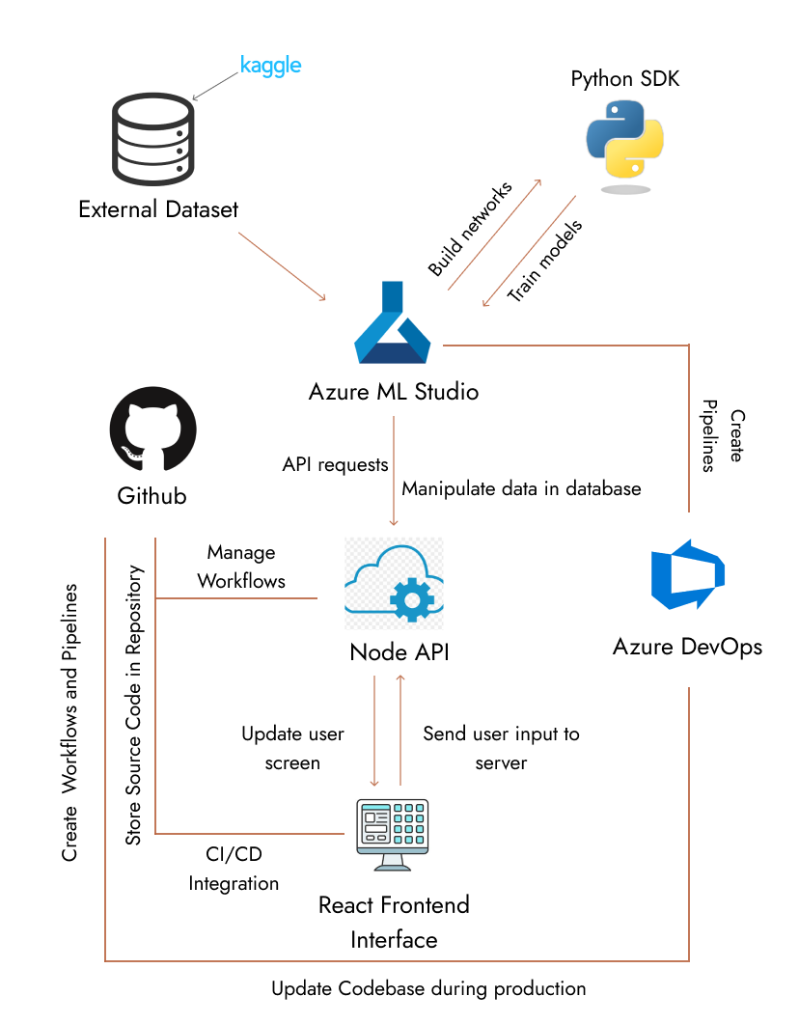
Methodology

Slide 11
Expected Outcomes
It is expected that the model has a 40% - 50% accuracy at predicting users with the virus.
The model should be able to advise cautionary measures for a patient predicted to have the virus
Notes:
Artificial Intelligence-enabled rapid diagnosis of patients with COVID-19 (Alsunaidi et al, 2021) using CT scans found that their model had a 68% prediction accuracy.

Slide 12
References
Alsunaidi et al (2021). Artificial Intelligence-enabled rapid diagnosis of patients with COVID-19
Abbasi et al (2021). An expert system to diagnose COVID-19 and predict its severity using chest CT scans
Abdel-Basst et al (2020). A model for the effective COVID-19 identification in uncertainty environment using primary symptoms and CT scans
Fauci et al (2020). COVID-19 Navigating the Uncharted. The New England journal o f medicine
Stojanovic et al (2020). A Headset Like Wearable Device to Track COVID-19 Symptoms.
Wu et al (2020). Characteristics of and Important Lessons From the Coronavirus Disease 2019 (COVID-19) Outbreak in China

Slide 13
References
Brown et al (2021). Exploring Automatic Diagnosis of COVID-19 from Crowdsourced Respiratory Sound Data. Health Day paper
Quiroz-Jua´rez et al (2021). Identification of high-risk COVID-19 patients using machine learning. PLoS ONE
Zoabi et al (2021). Machine learning-based prediction of COVID-19 diagnosis based on symptoms. Digital Medecine
McAleer, M (2020). Prevention Is Better Than the Cure: Risk Management of COVID-19. Journal of Risk and Financial Management
Giri et al (2020). Charting the challenges behind the testing of COVID-19 in developing countries: Nepal as a case study

Slide 14
THANK YOU!

